Slide 1


Slide 2
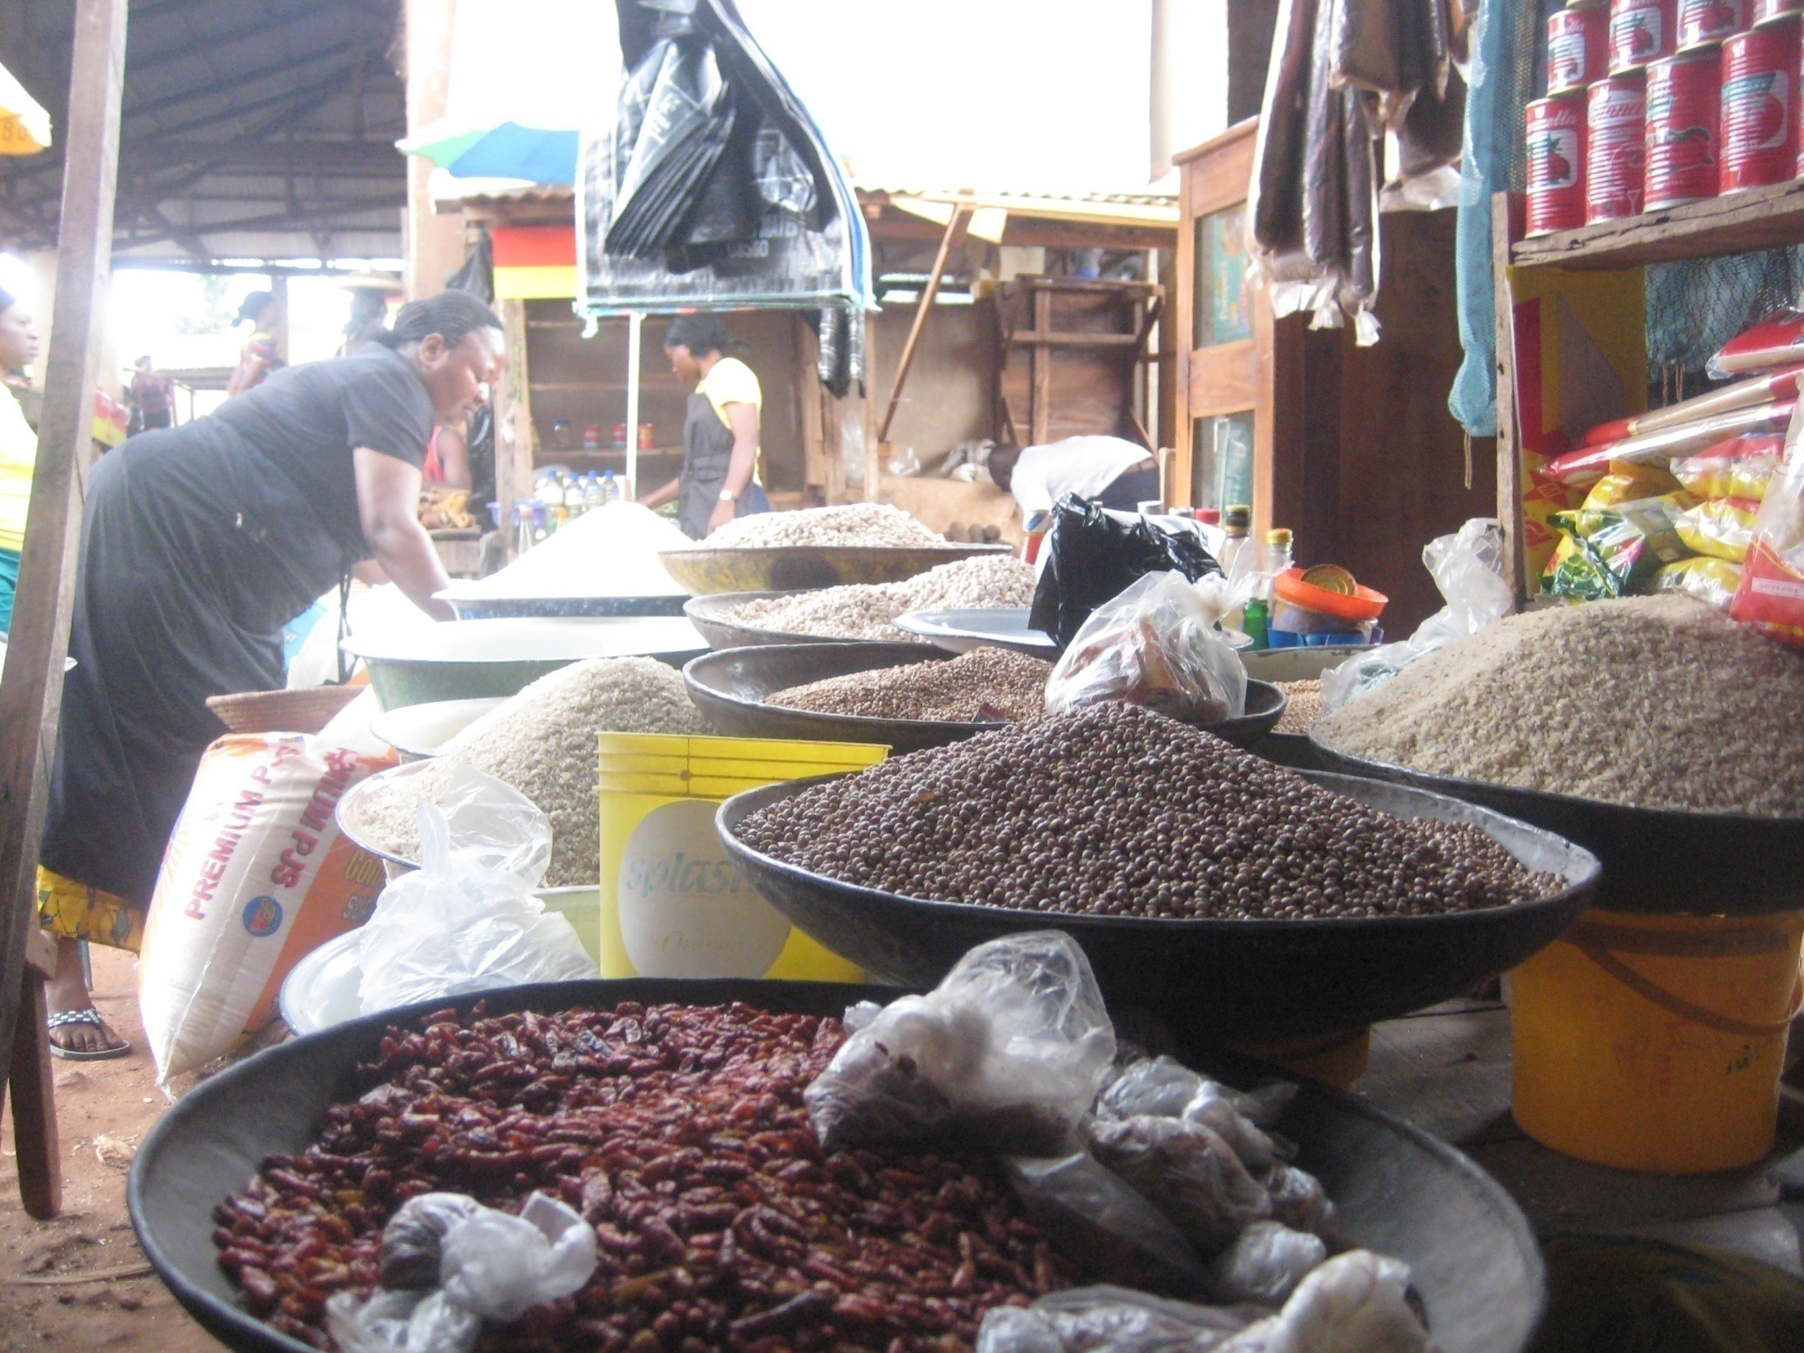
Enugu 2009

Slide 3
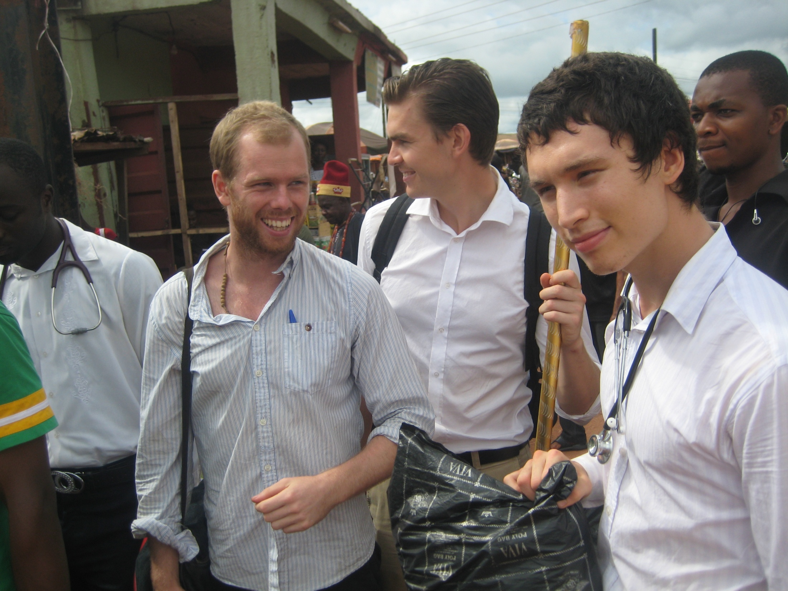

Slide 4
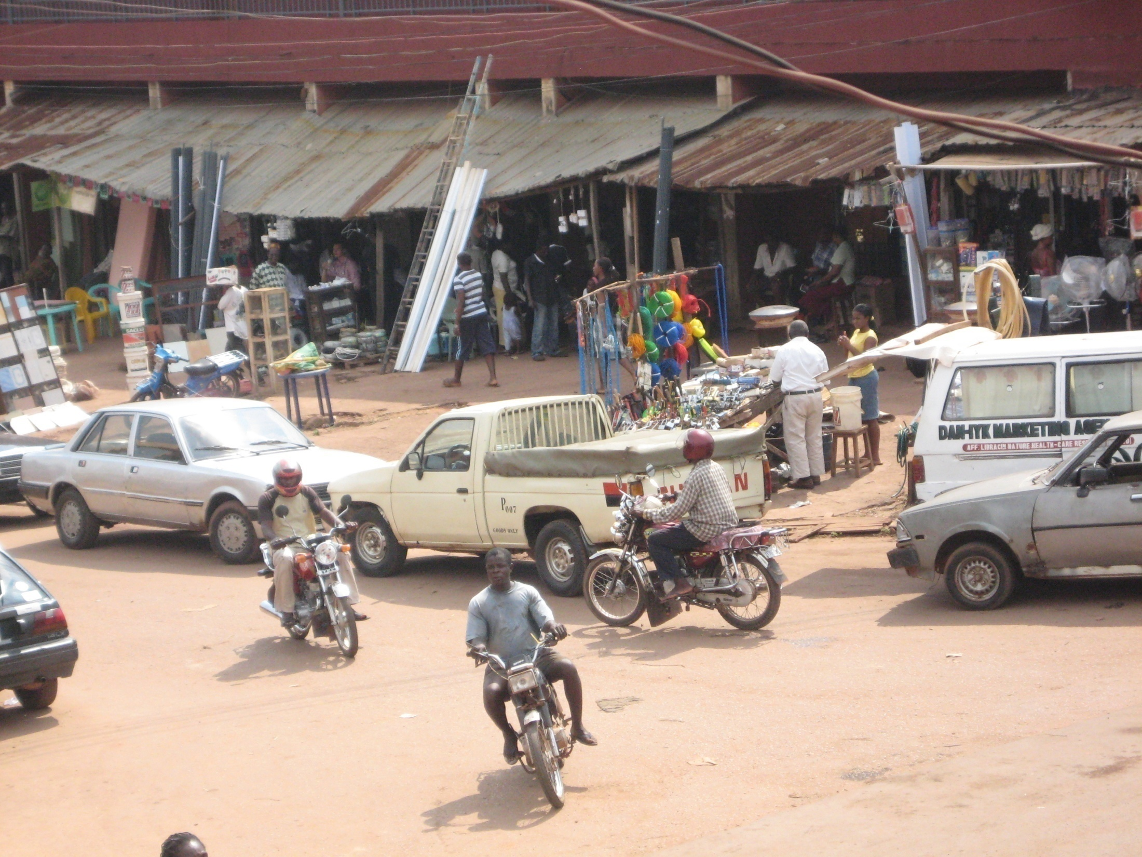

Slide 5
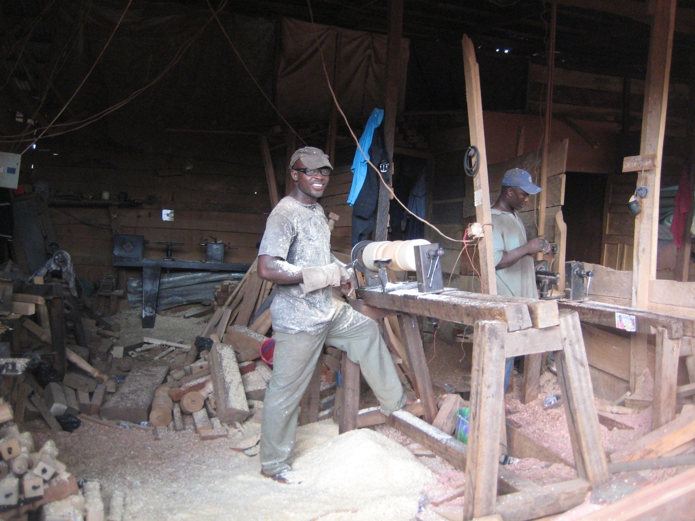

Slide 6
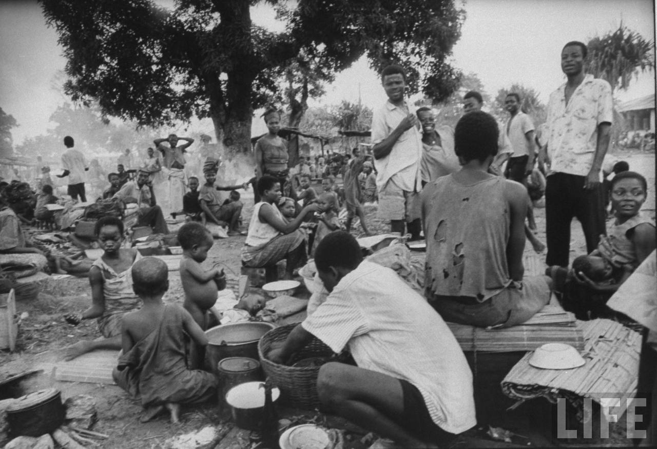
Enugu 1969

Slide 7
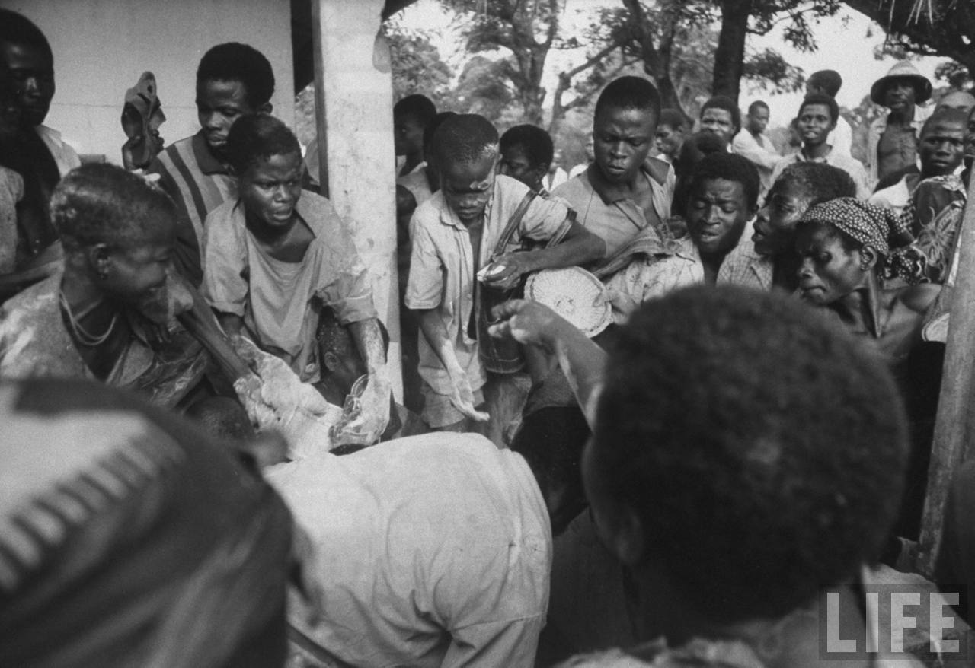
Hälsoeffekter idag?

Slide 8
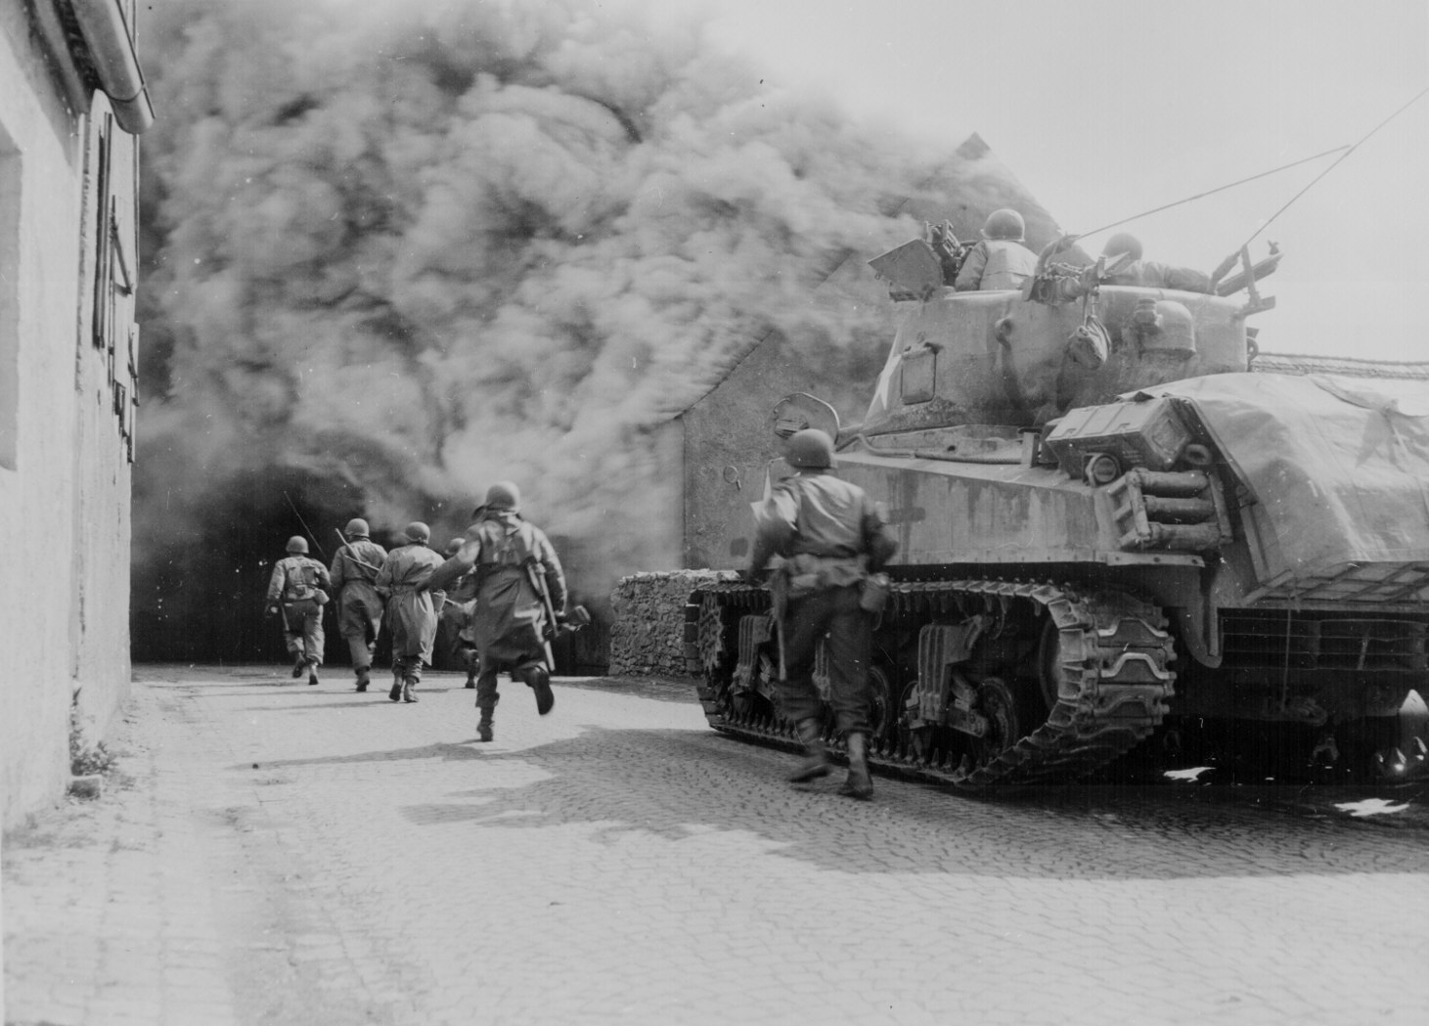
WWII
Notes:
sounds

Slide 9
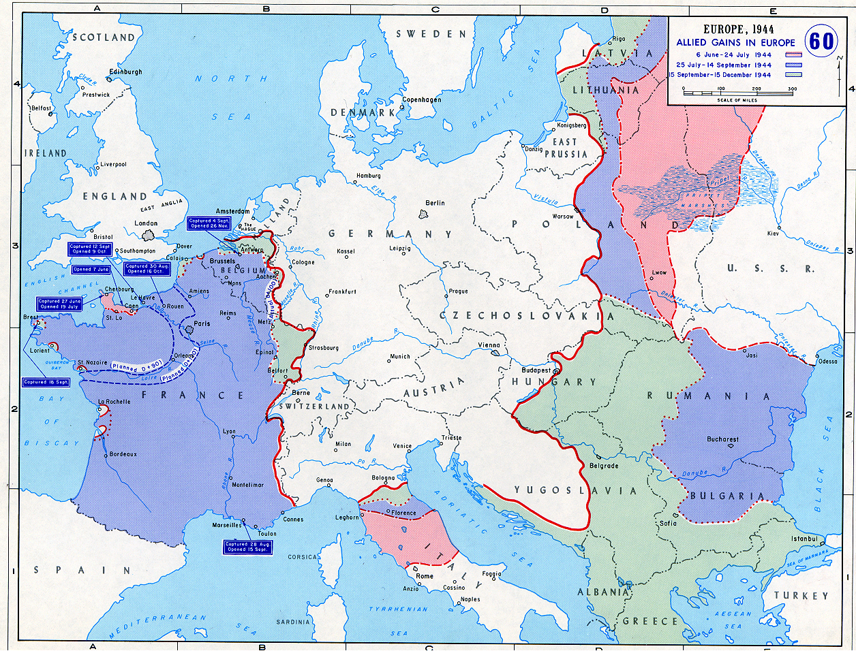
Holland

Slide 10
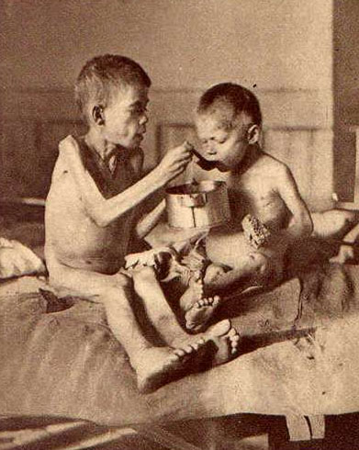
Hongerwinter
1944

Slide 11

Svältexponering i fosterlivet
var associerat med
högt blodtryck,
och pre-diabetes
Roseboom TJ et al.
Ravelli AC et al.
Notes:
And it has been found that fetal exposure to the dutch famine

Slide 12
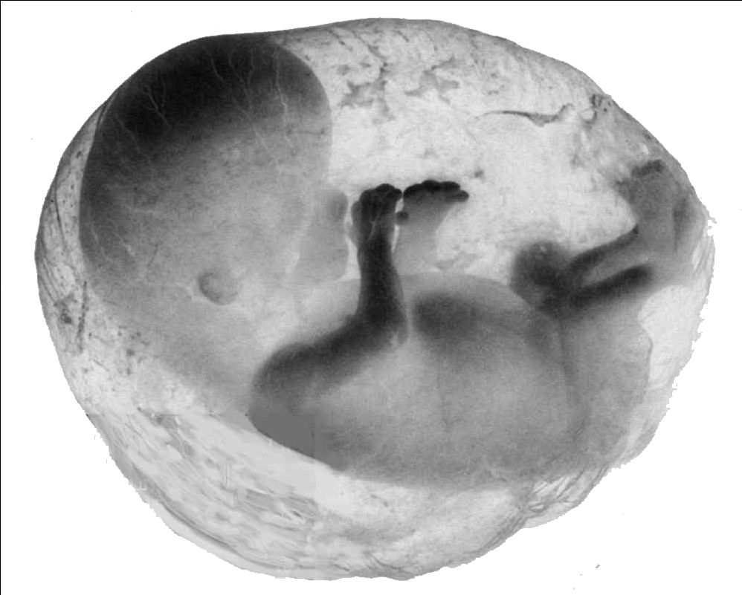
Fetal
programming
Notes:
These findings belong to a research field called developmental programming; linking events in very early life to health outcomes later in life

Slide 13
Biafra-krisen

Slide 14


Republiken Biafra
Maj 1967

Slide 15
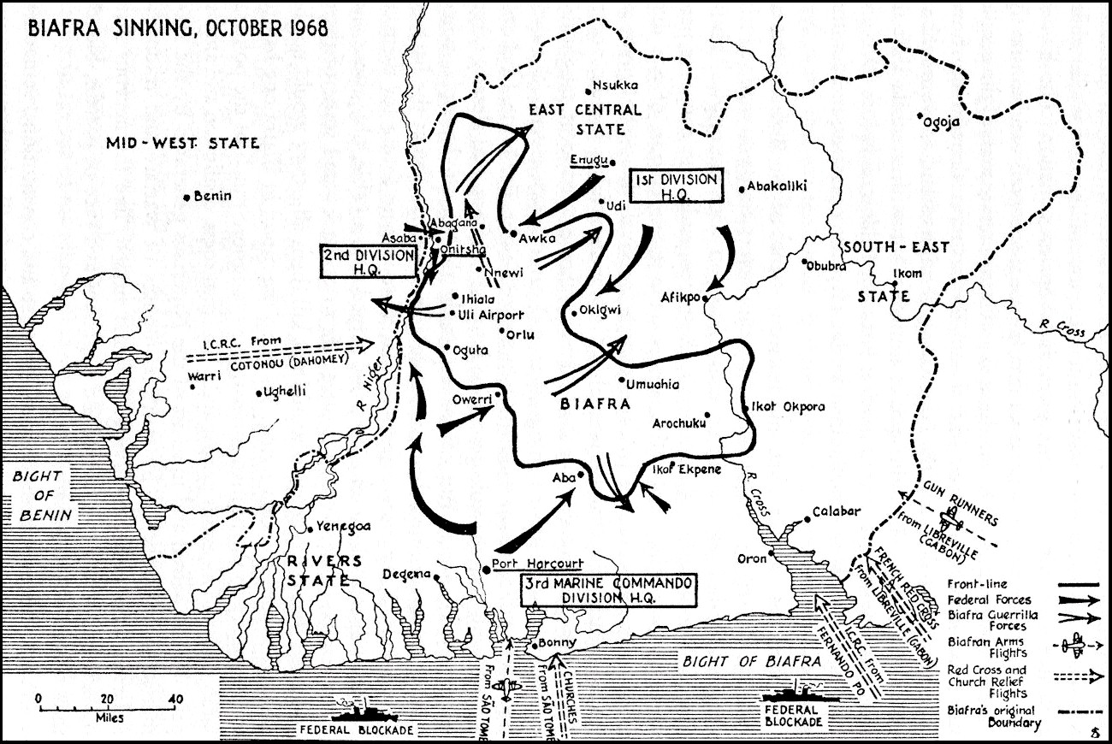

Slide 16
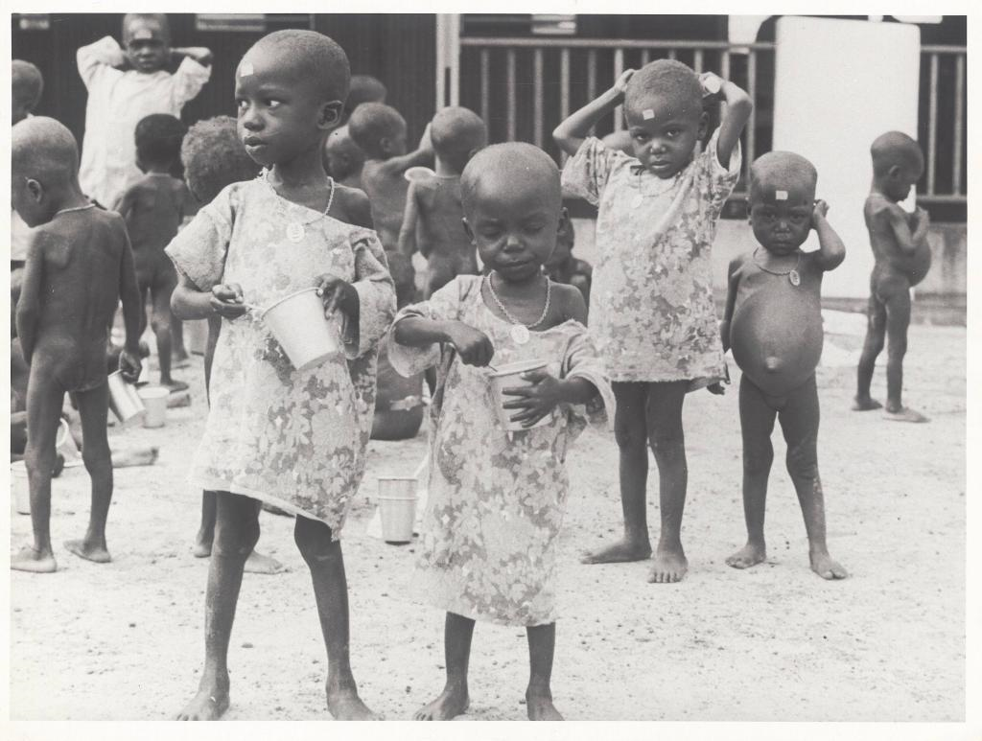
Notes:
Of the 1-3 million Biafrans that is estimated to have lost their lives in the war, 90% starved to death

Slide 17
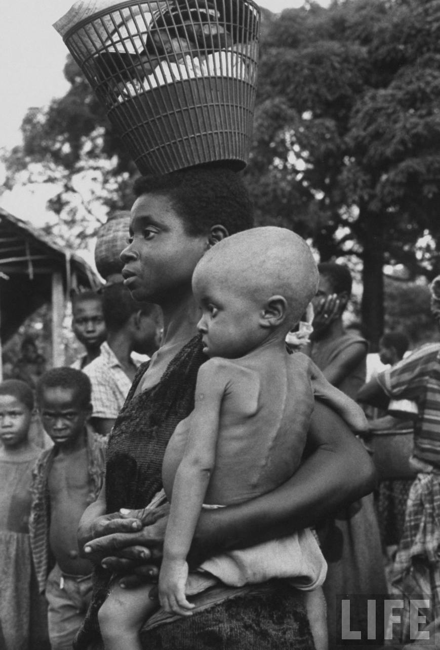

Slide 18
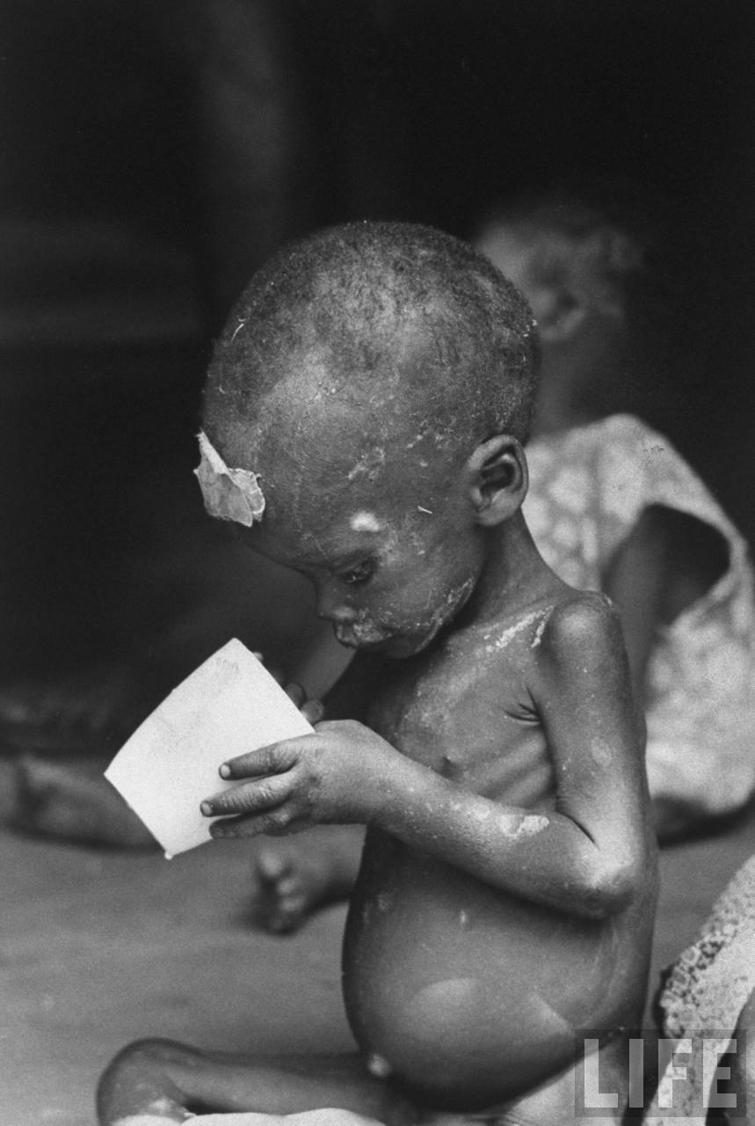

Slide 19
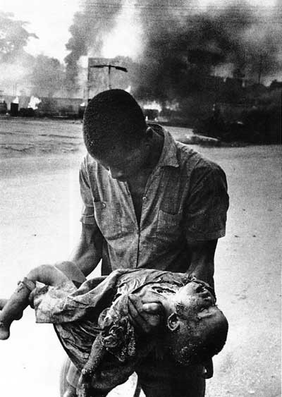
Biafrakrisen

Slide 20
Biafrakrisen
Svält

Slide 21
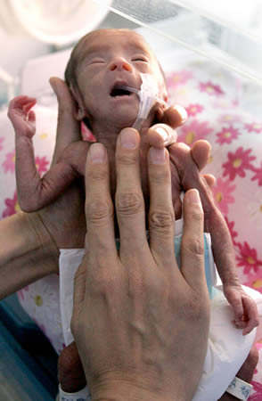
Biafrakrisen
Svält
fetal
malnutrition

Slide 22
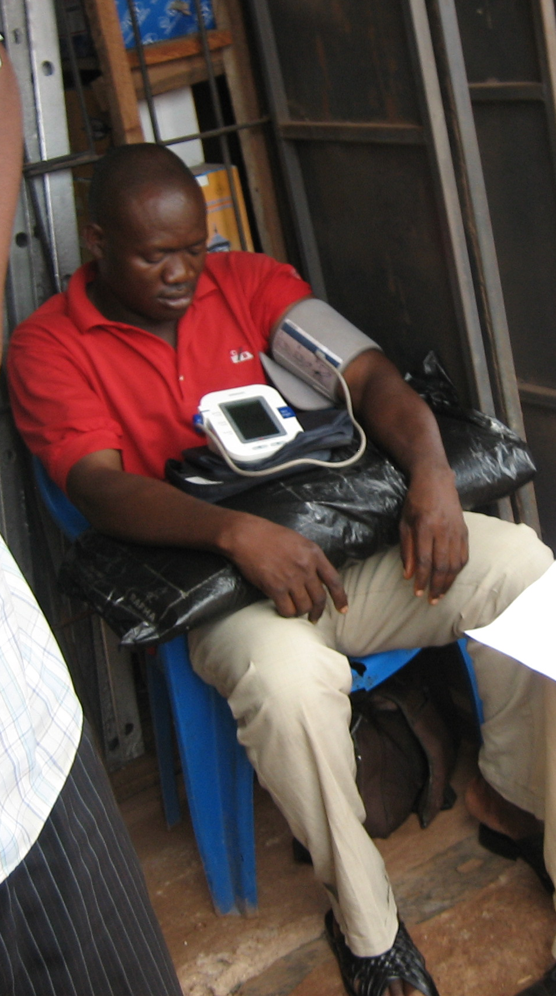
Biafrakrisen
Svält
fetal
malnutrition
Högt blodtryck & diabetes?

Slide 23
Resan

Slide 24

Notes:
Sound!

Slide 25

I bästa fall
kommer ni hem, Förhoppningsvis i ett stycke

Slide 26


Slide 27
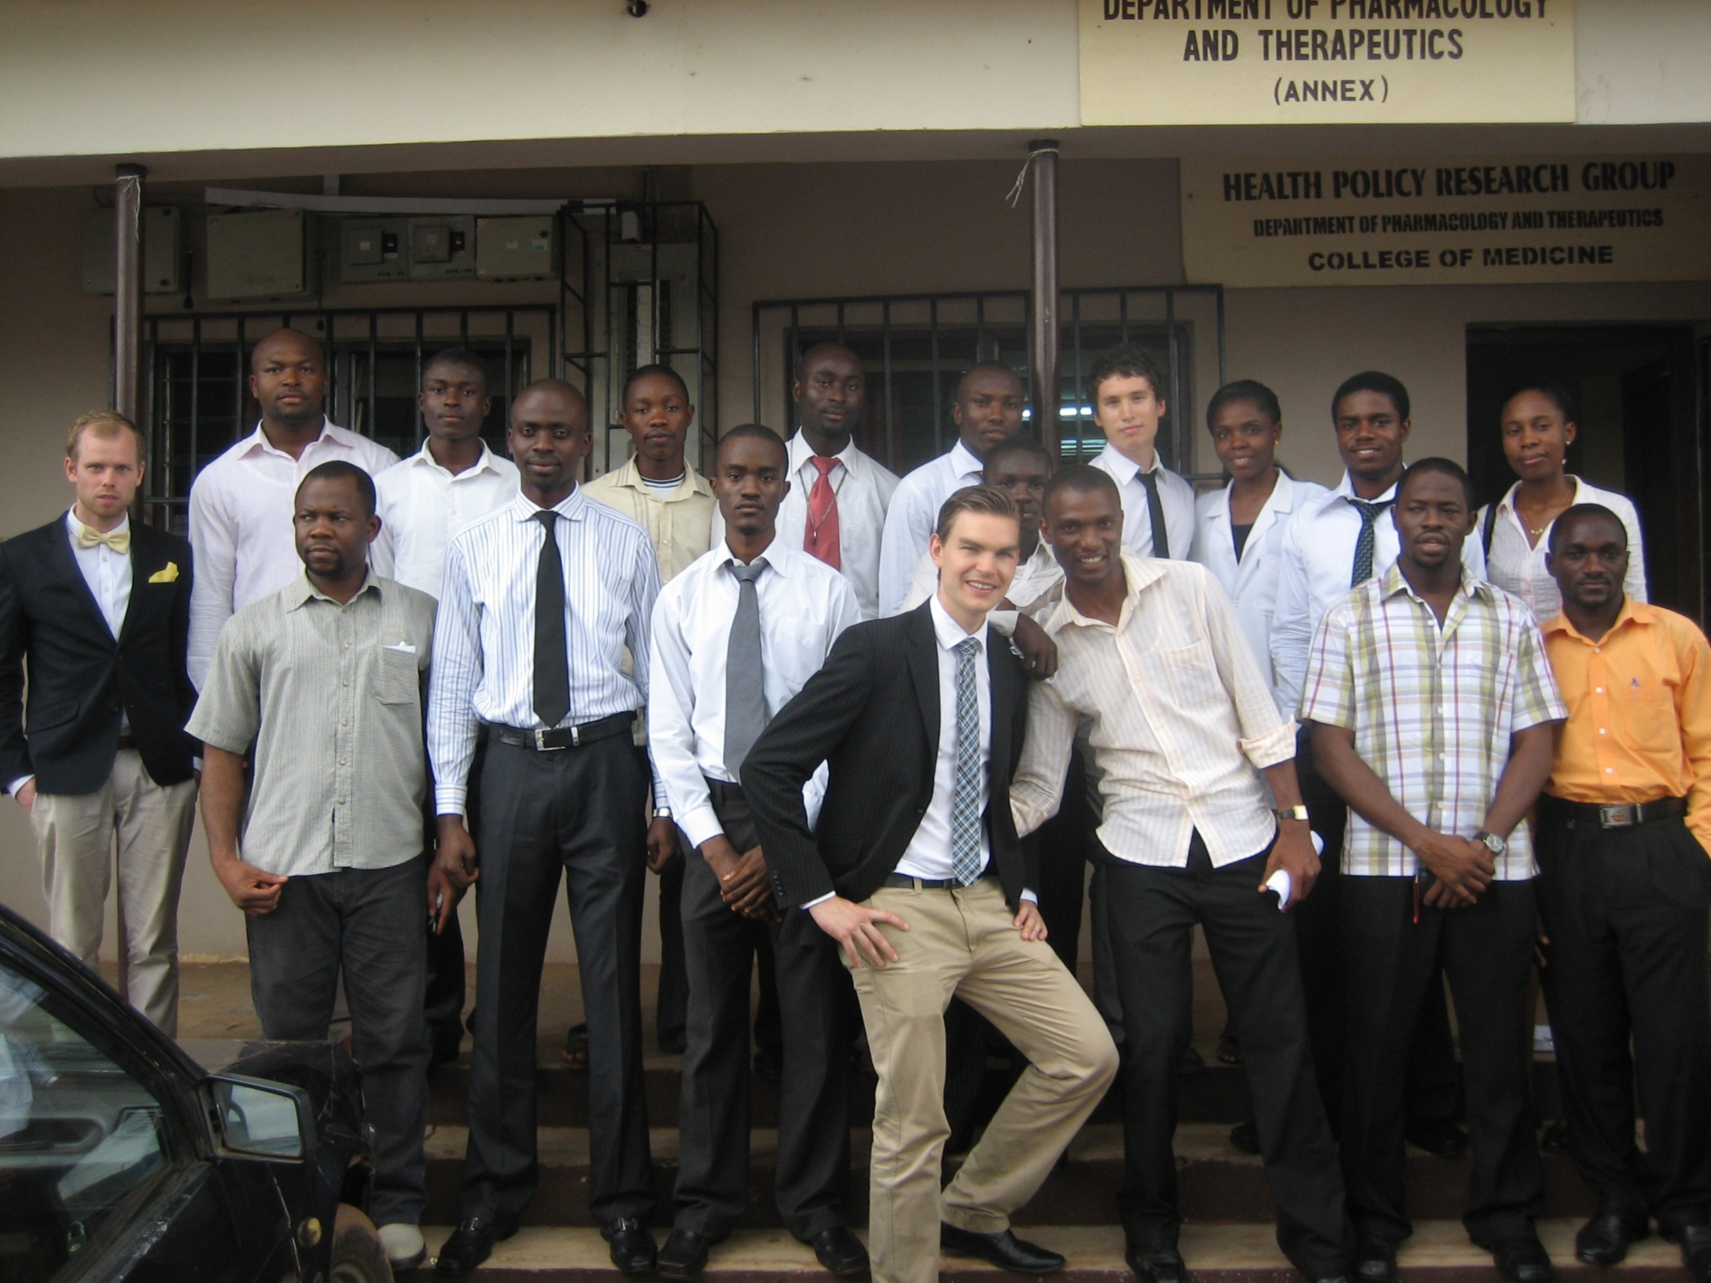

Slide 28
Metod

Slide 29
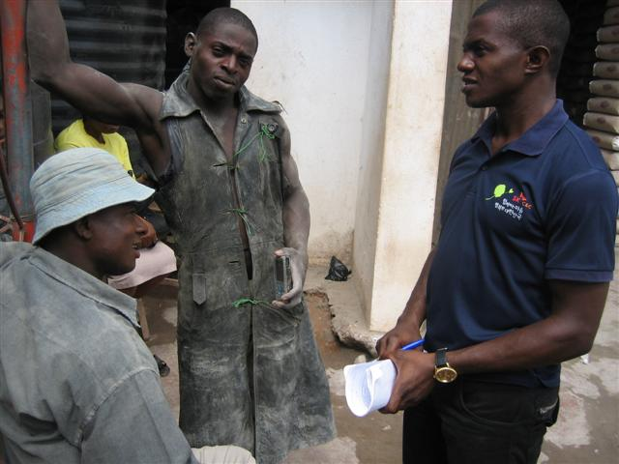

Slide 30
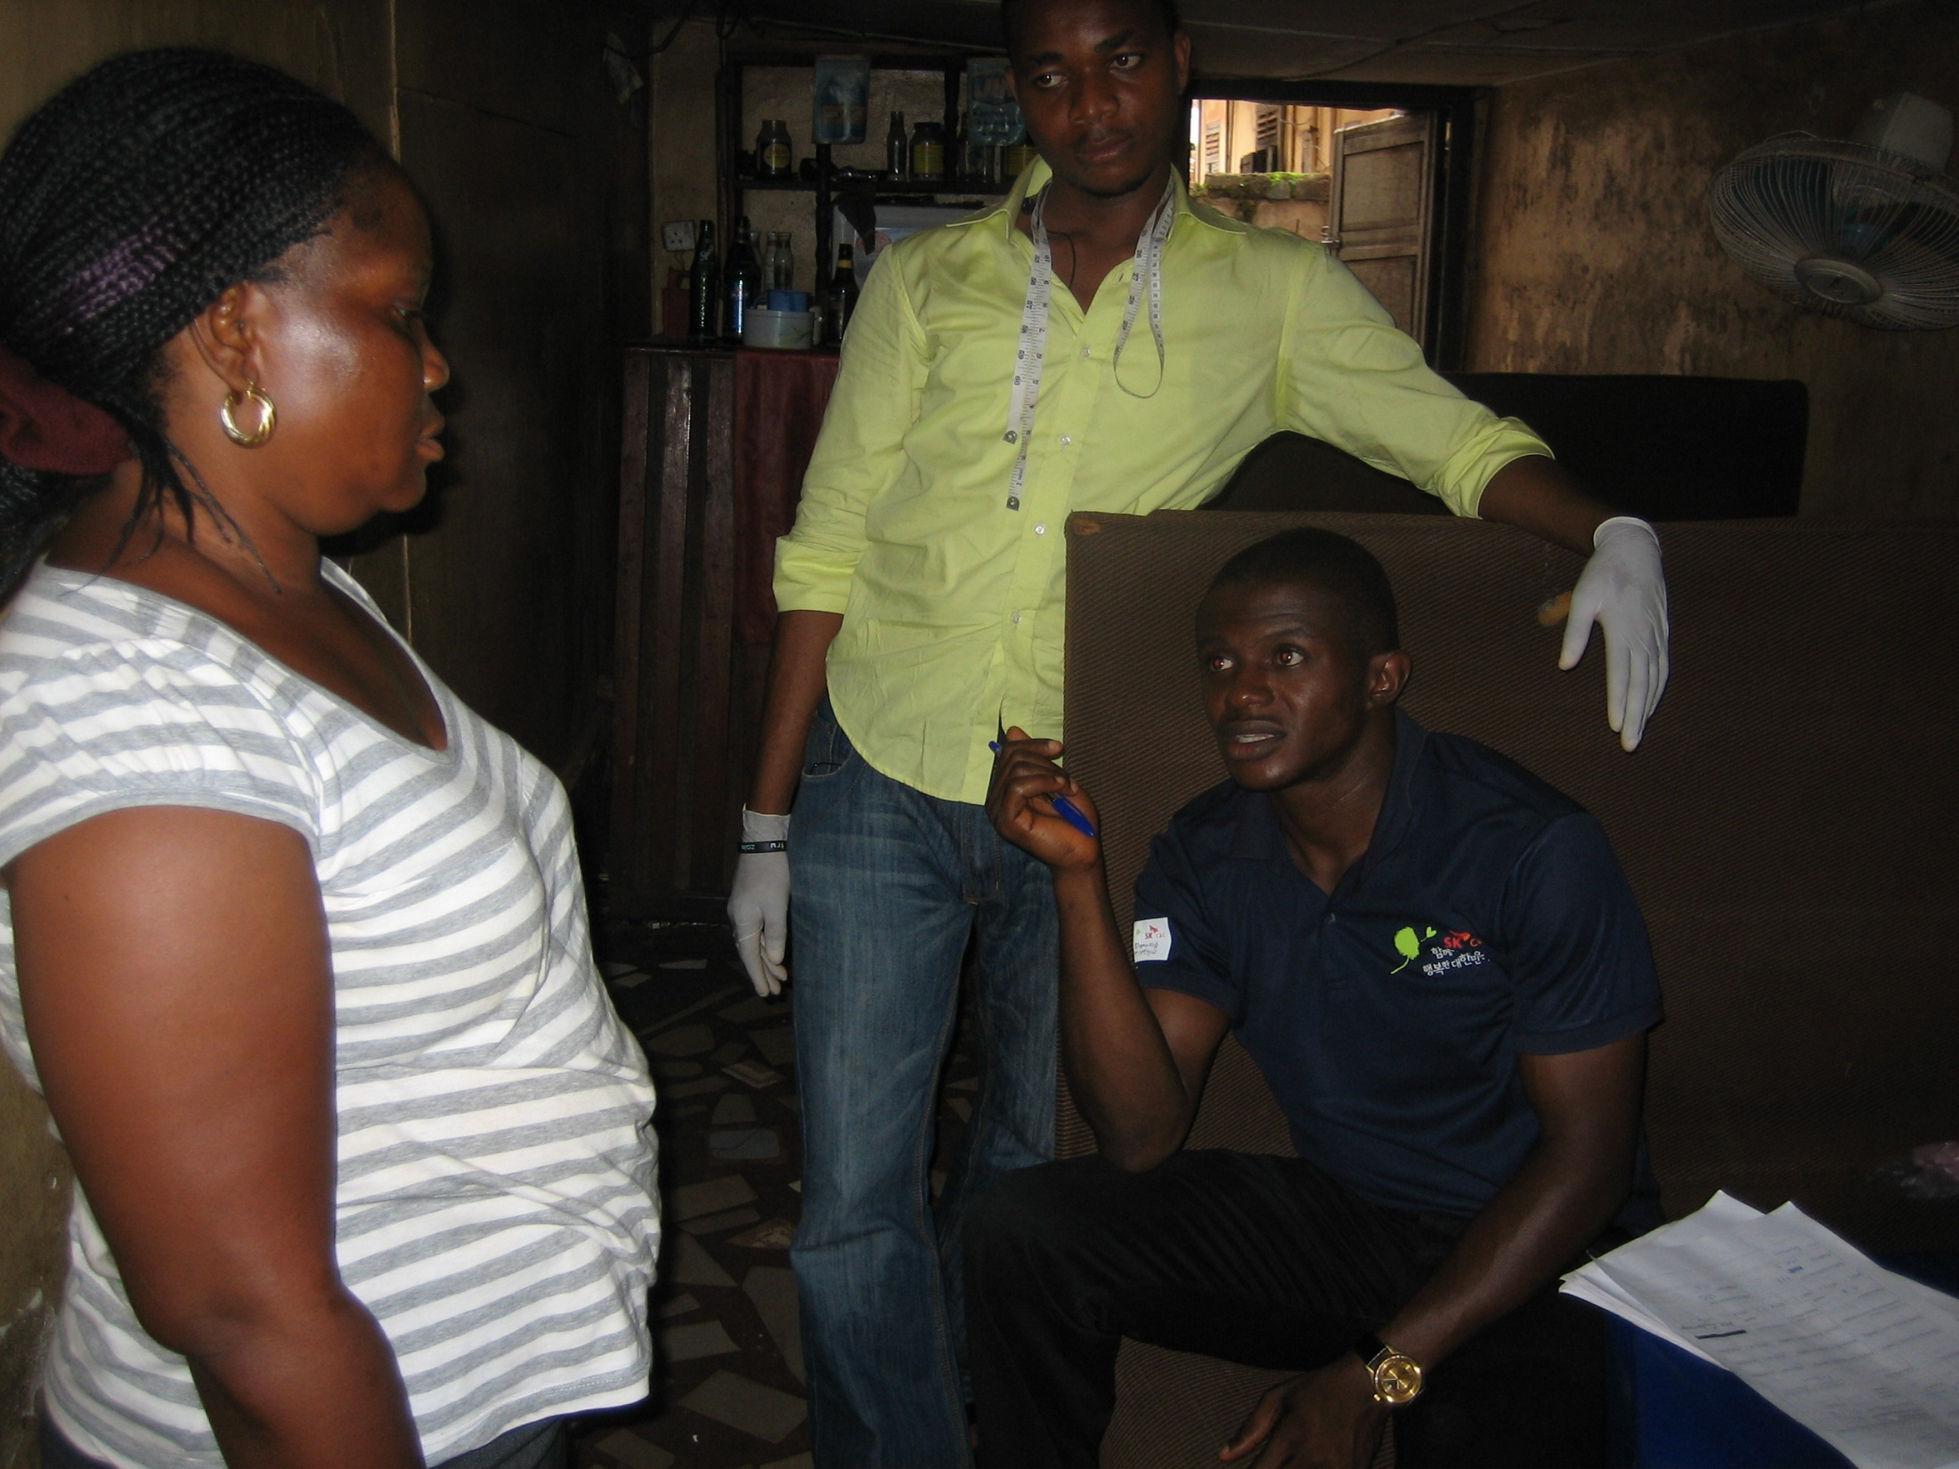

Slide 31
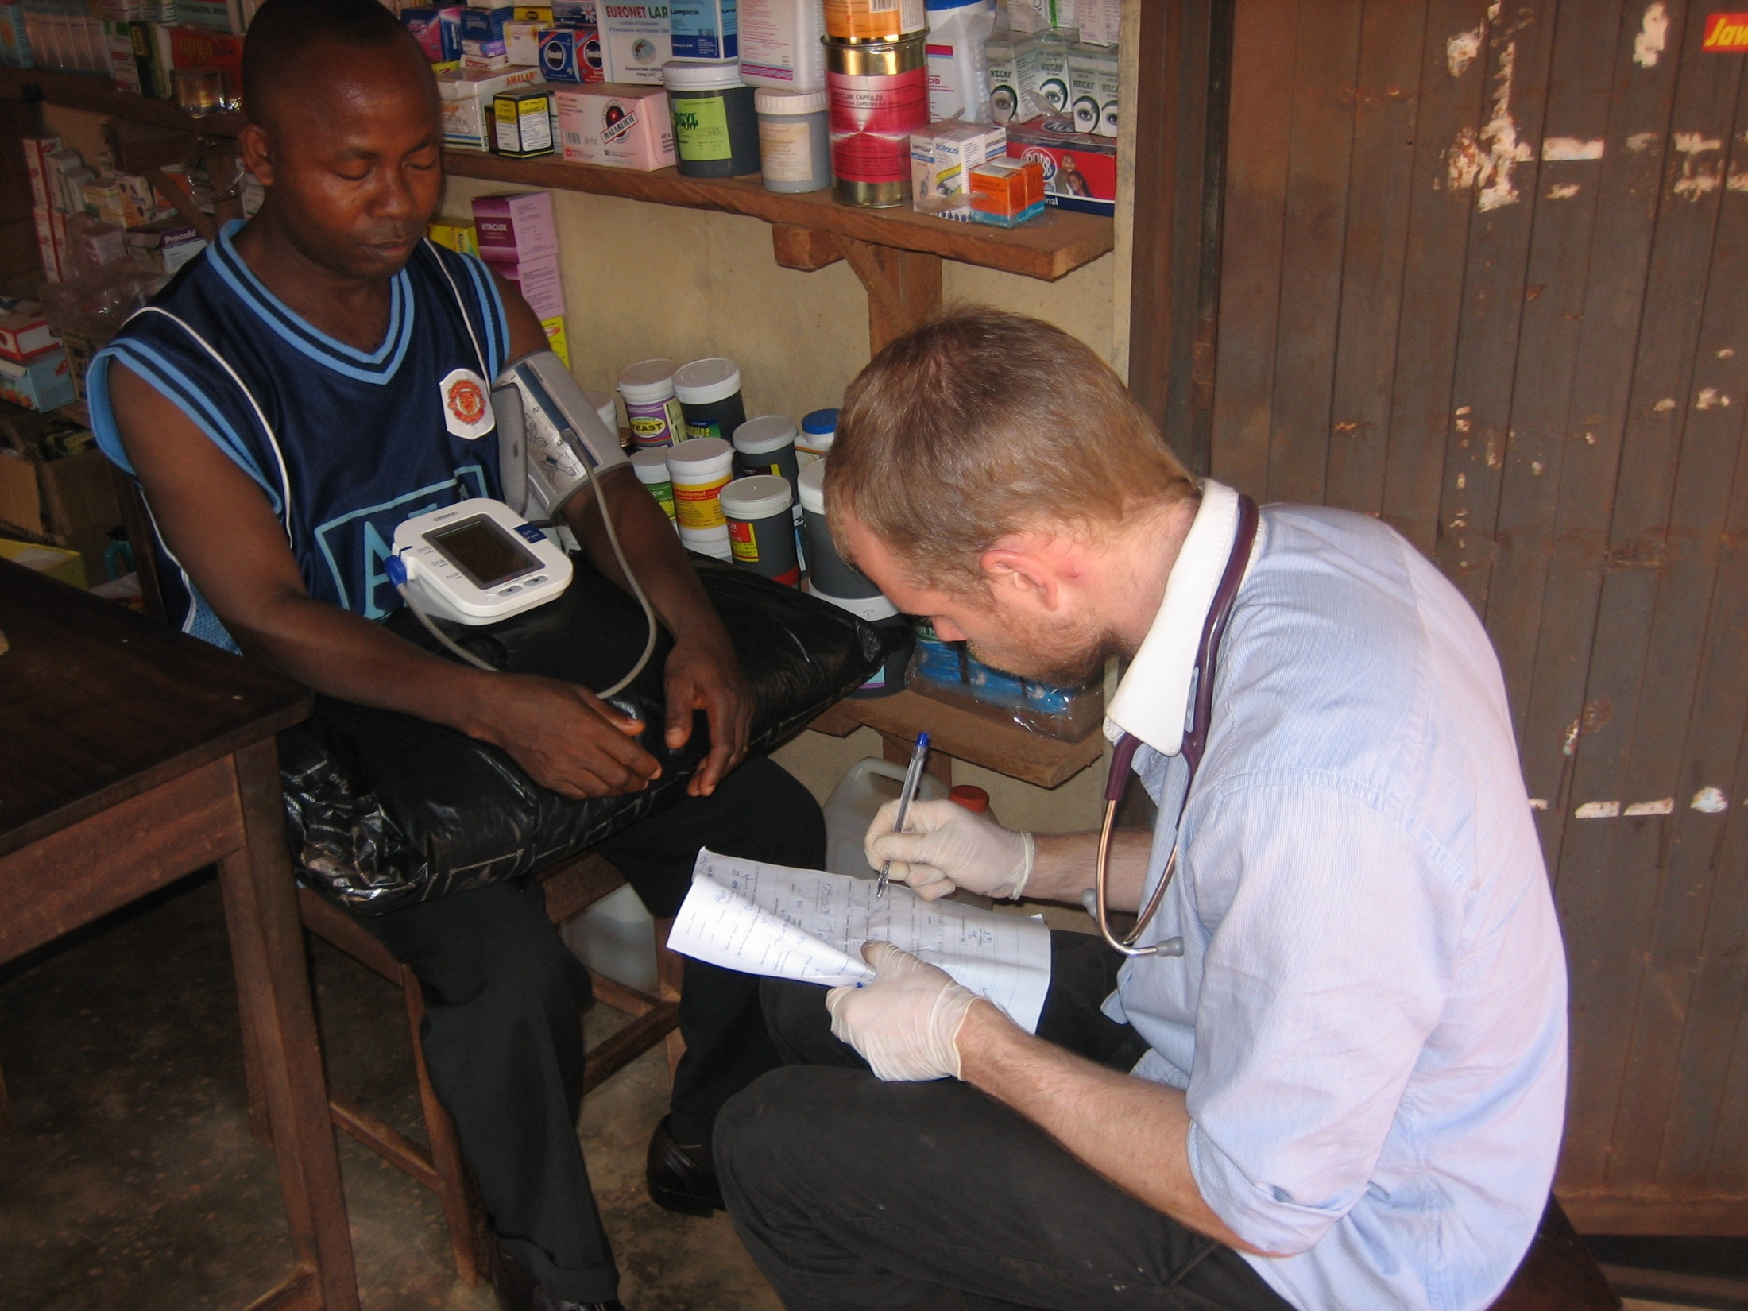

Slide 32
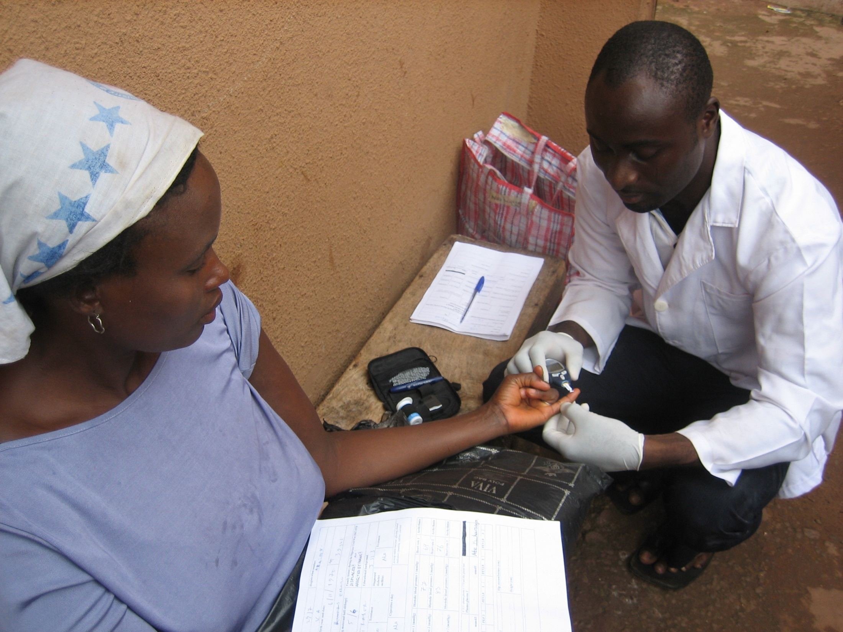

Slide 33
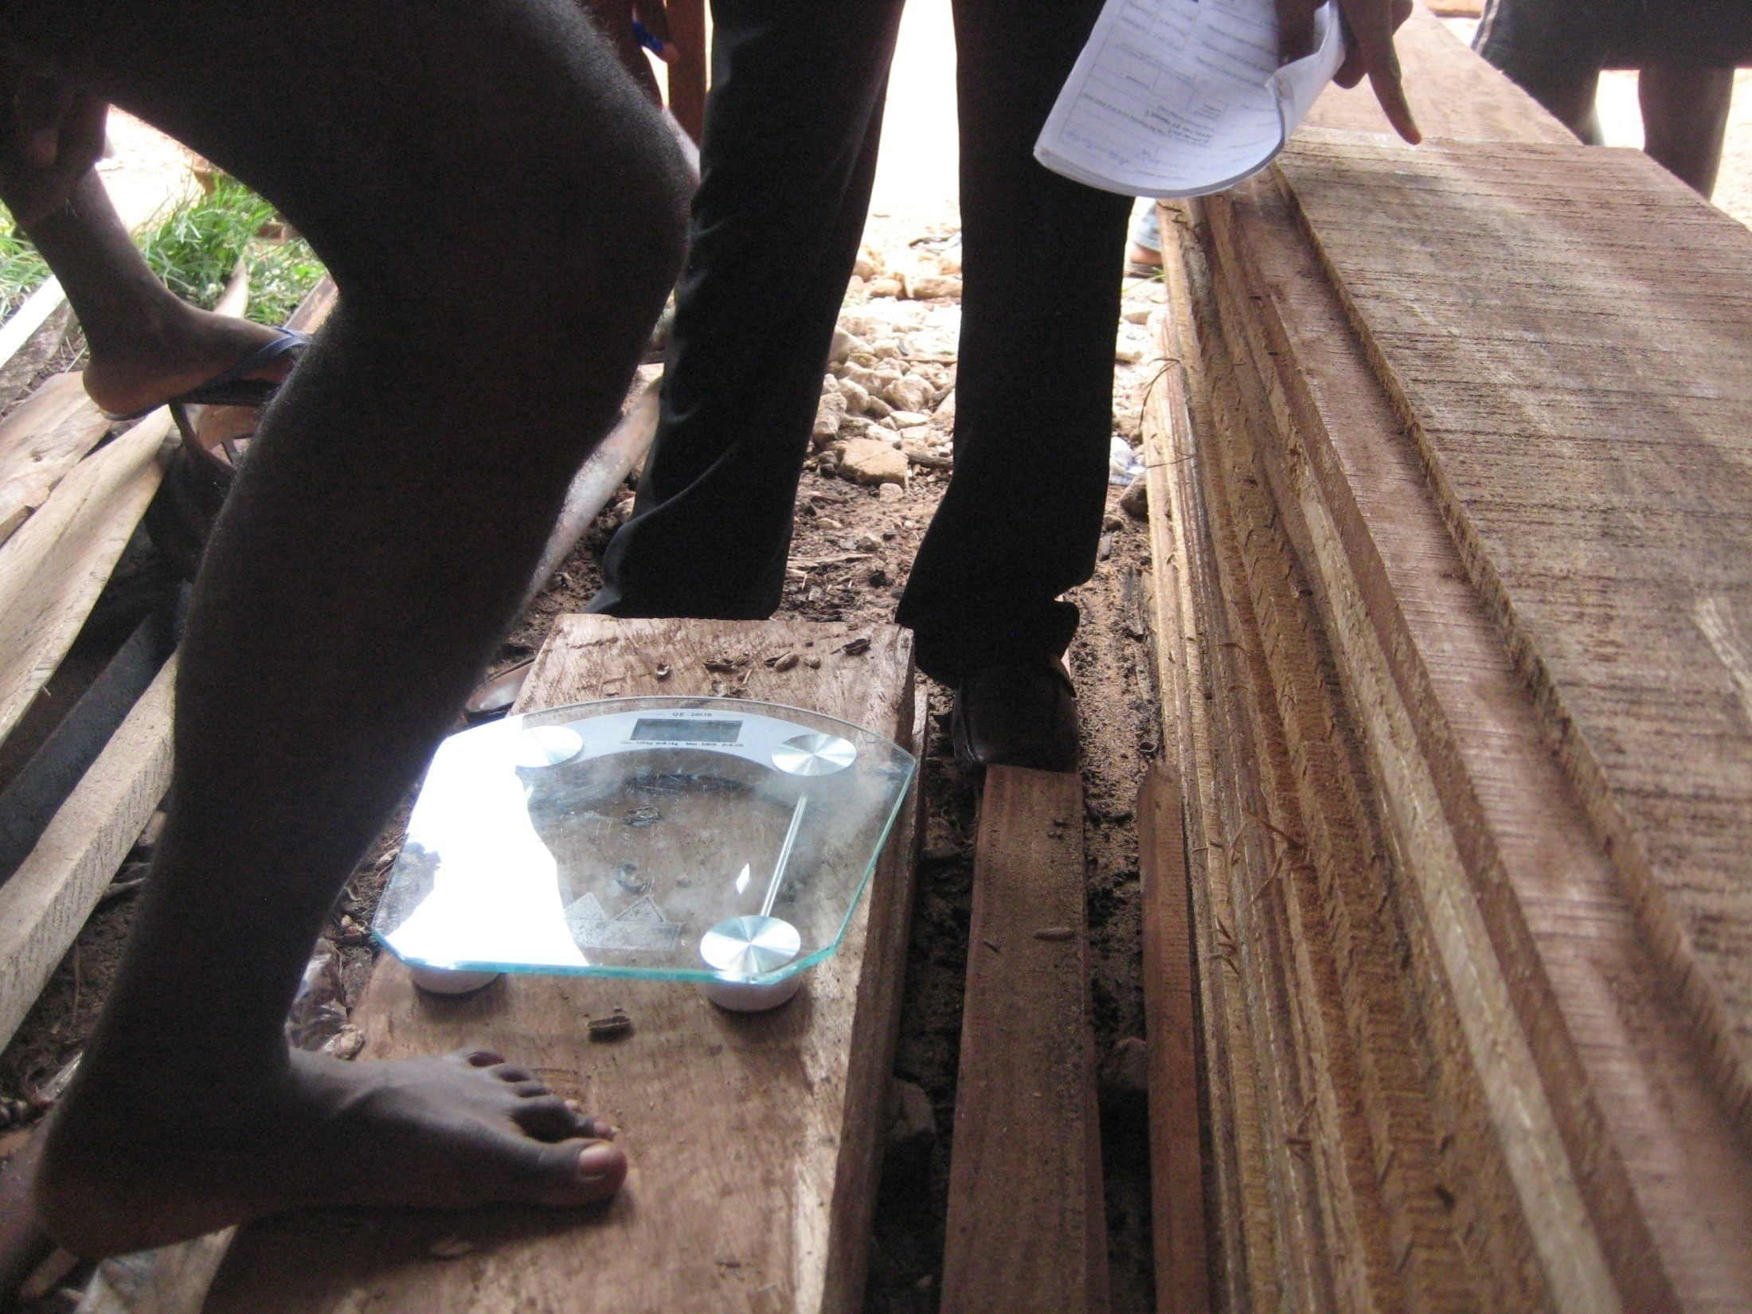

Slide 34
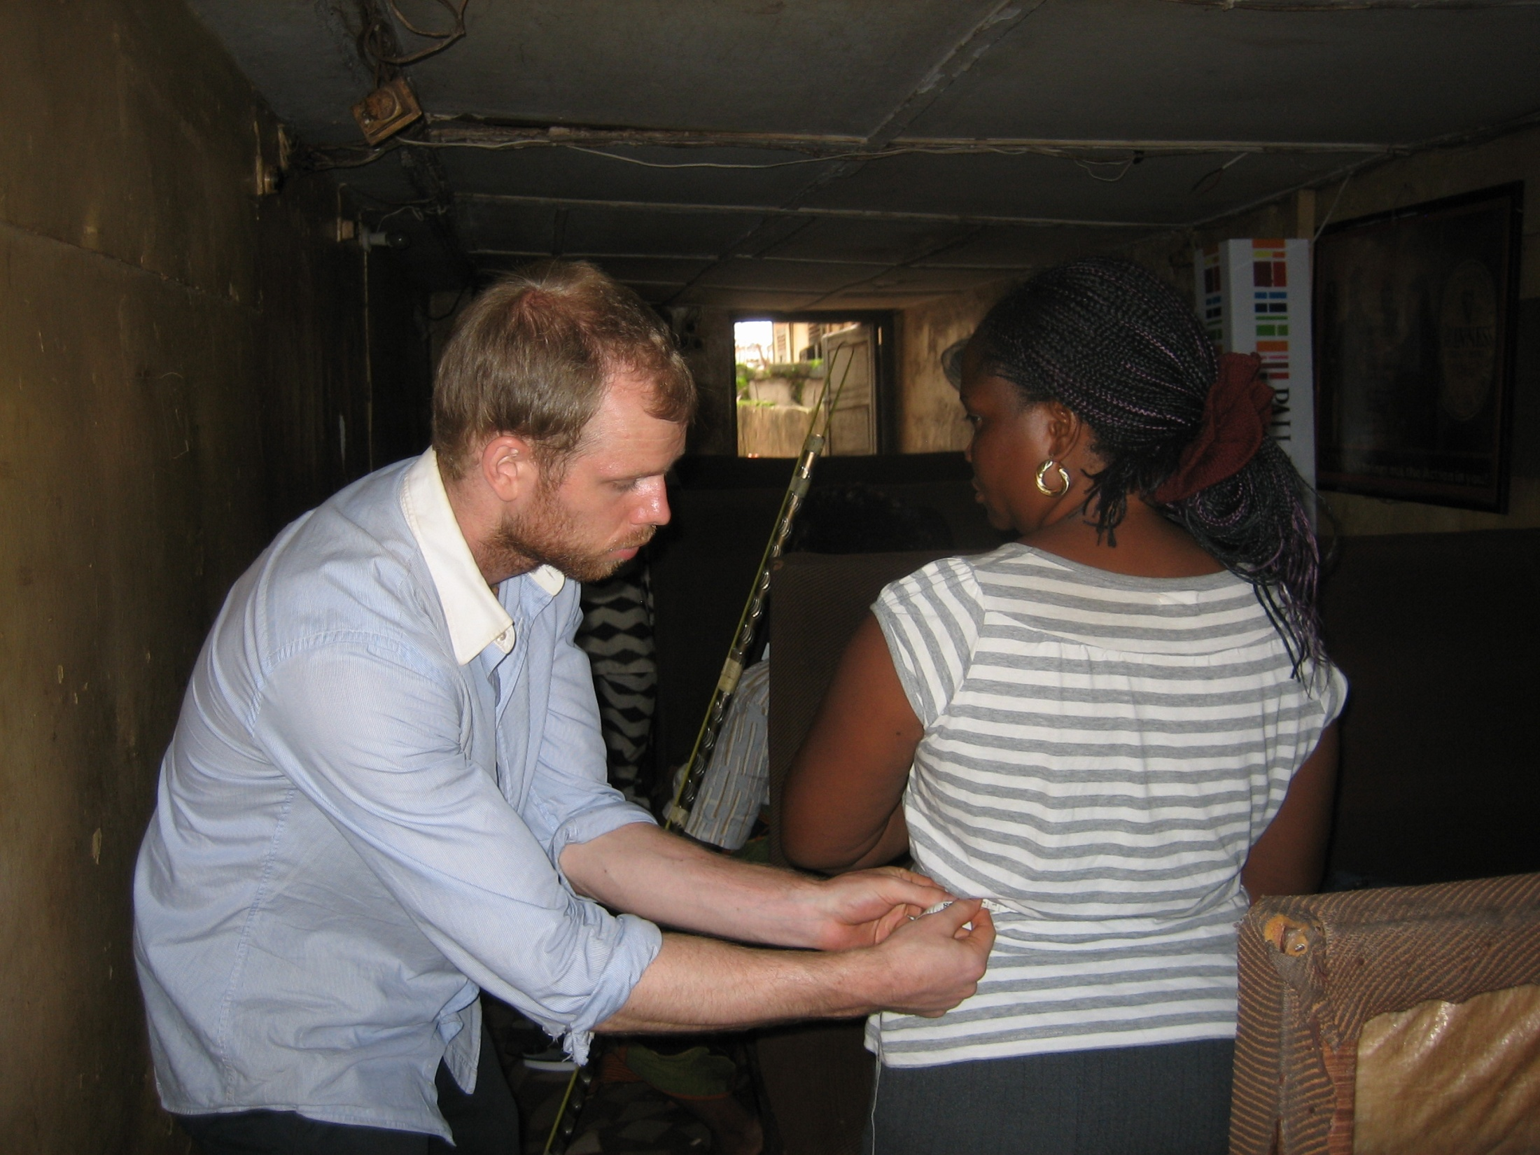

Slide 35
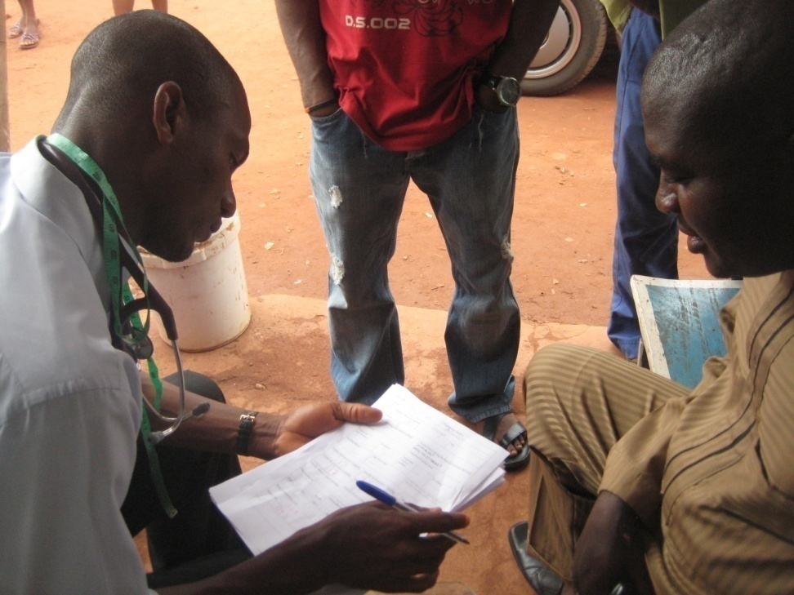

Slide 36
Resultat

Slide 37
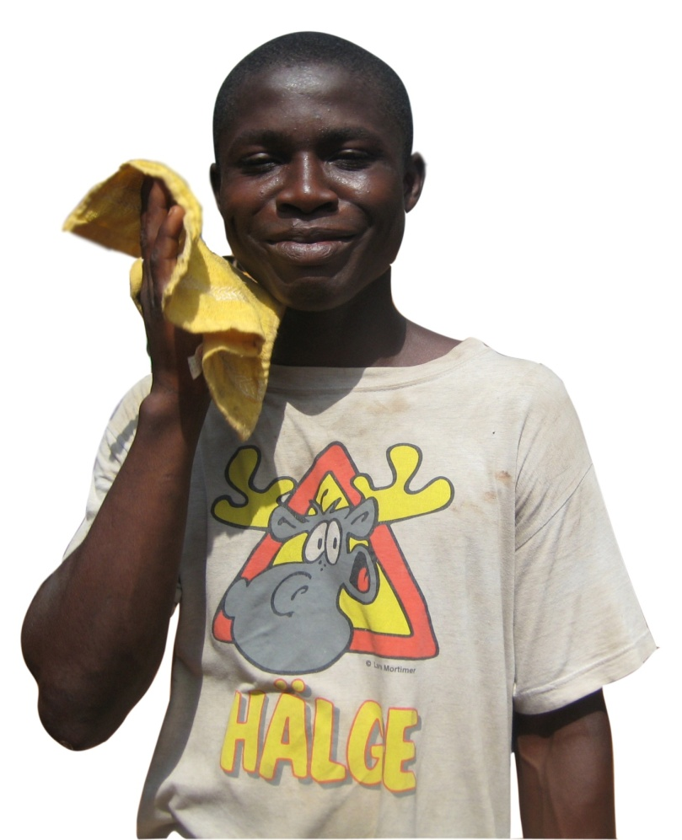
1339
personer
n=
1965-67 | Barndom | 398
1968-70 (Jan) | Fosterliv | 292
1971-73 | Ej exponerade | 486

Slide 38

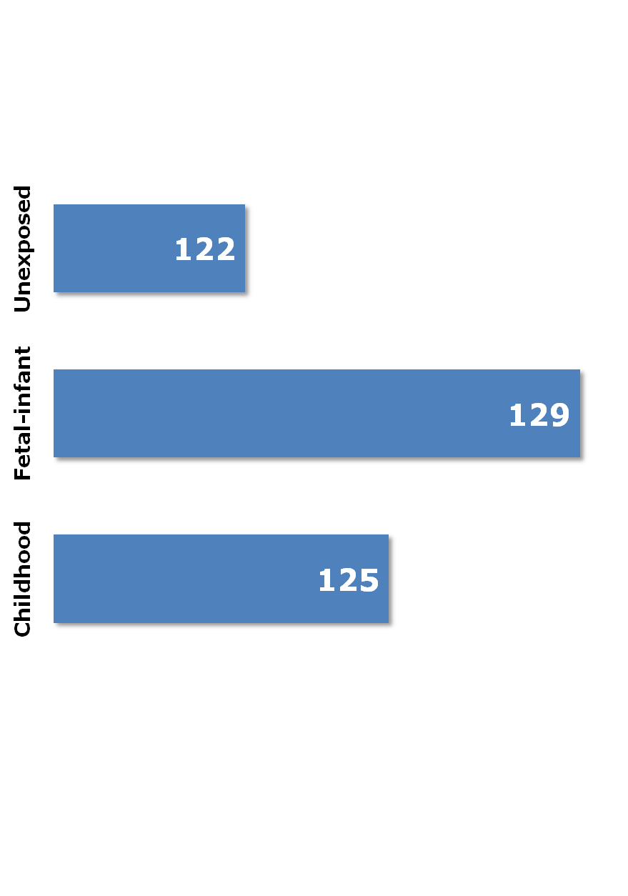
7
(4.4 <diff<9.6)
4
(1.3<diff<6.7)
mmHg

Slide 39

1.67
1.58
0.96
1.01
1
0.96
0.78
0.54
Odds ratio för systolisk hypertoni
1967 som referens

Slide 40

 | DM | IGT
Barndom | 1.88 (0.66-5.33) | 1.15 (0.70-1.86) ()
Fosterliv | 3.11 (1.14-8.51) | 1.76 (1.09-2.85)
Oexponerad | 1 | 1
Odds ratios of IGT (7.8mmol/L ≤ RPG < 11.0 mmol/L)
Diabetes Mellitus: (RPG ≥ 11.0 mmol/L) Unexposed group as reference

Slide 41

Barndom | 1.02 (0.77-1.34) | 62%
Fosterliv | 1.41 (1.03-1.93) | 69%
Oexponerad | 1 | 62%
OR och prevalens BMI>25 kg/m³ Oexponerade (1971-73) som referens
Notes:
FIX NUMBERS, FIND NEW PIC

Slide 42
Relevans

Slide 43
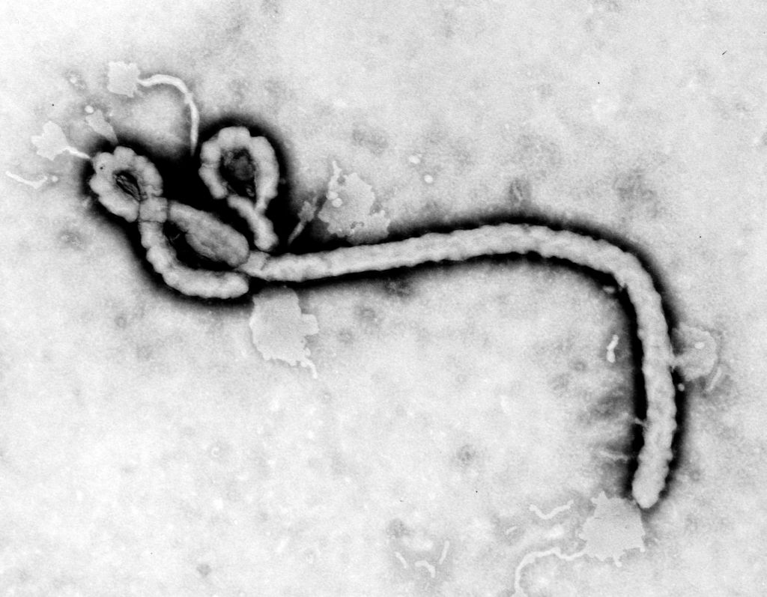

Slide 44


Slide 45
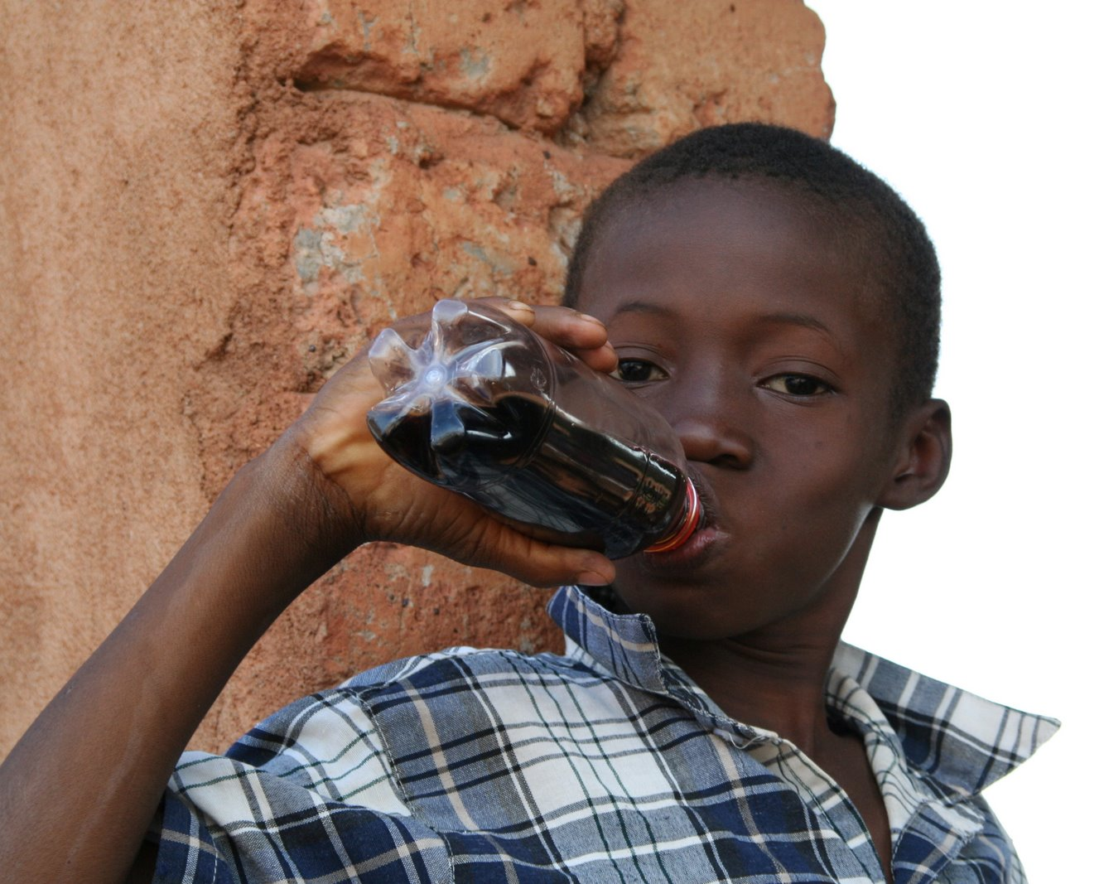
80
%
Notes:
of all new cases of diabetes expected to appear in the developing countries by 2025

Slide 46
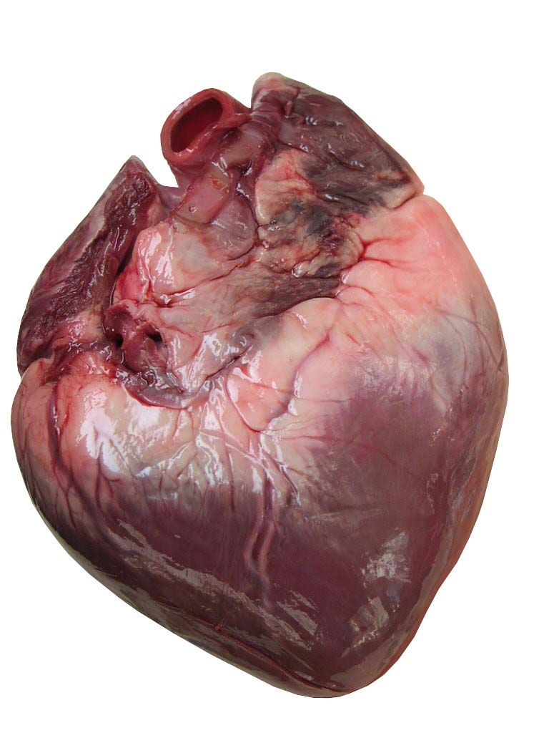
85
%
Notes:
of cardiovascular
deaths worldwide will occur in developing countries by 2030

Slide 47
Ledande
dödsorsaken i
utvecklingsländer

Slide 48

20 miljoner
Notes:
low birth weight
infants yearly in the developing
countries

Slide 50
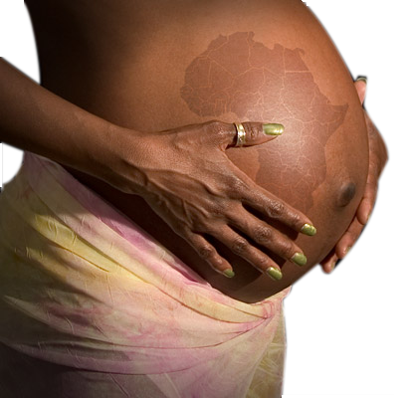
Notes:
Eradicate extreme poverty and hunger
Reduce child mortality
Improve maternal health
Importance of food relief during
humanitarian crisis and wars

Slide 51
Notes:
Eradicate extreme poverty and hunger
Reduce child mortality
Improve maternal health
Importance of food relief during
humanitarian crisis and wars

Slide 52
Slutligen...

Slide 53


Slide 54
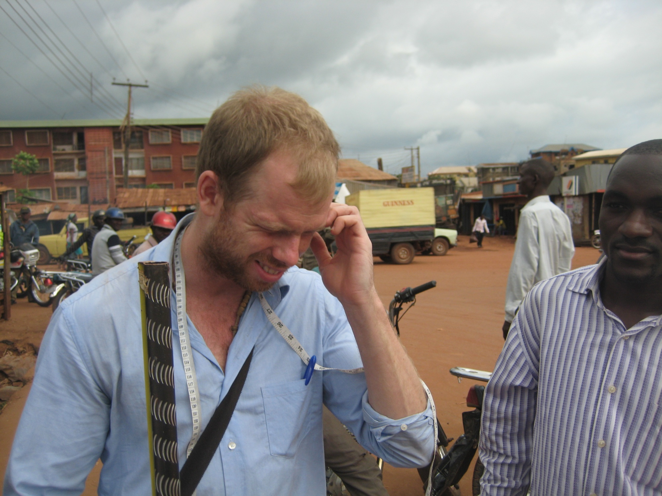

Slide 55


Slide 56
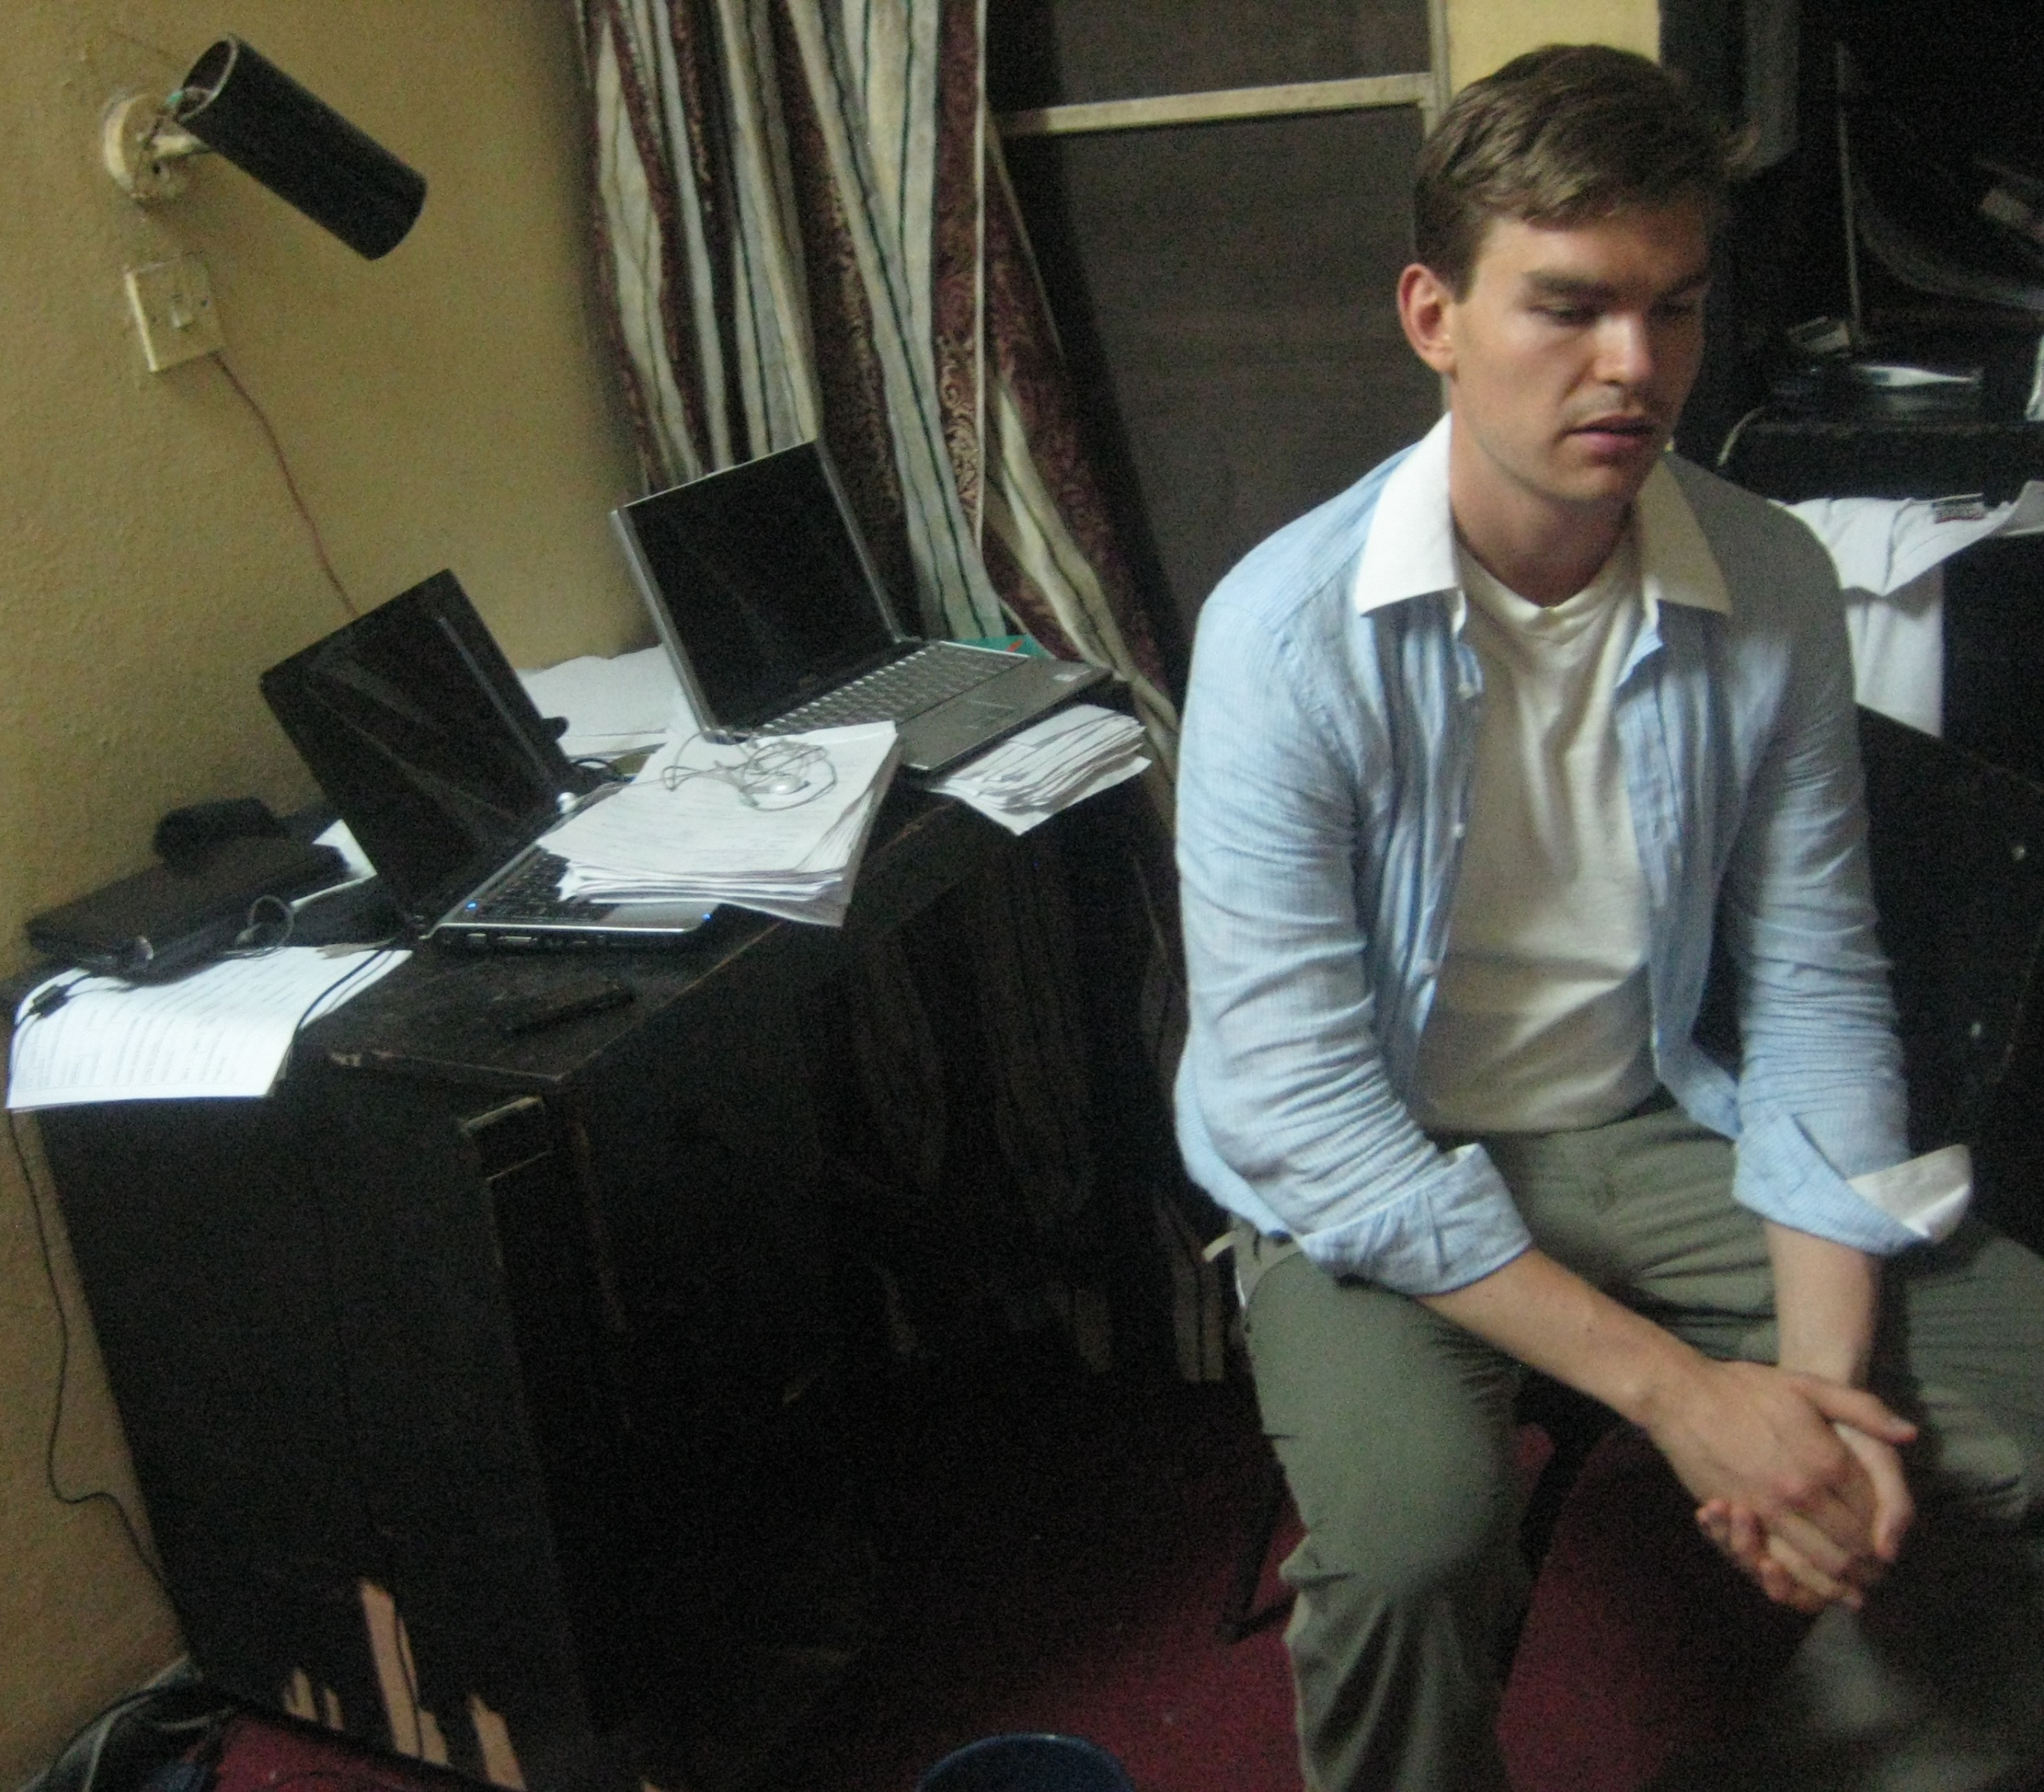

Slide 57



Slide 58
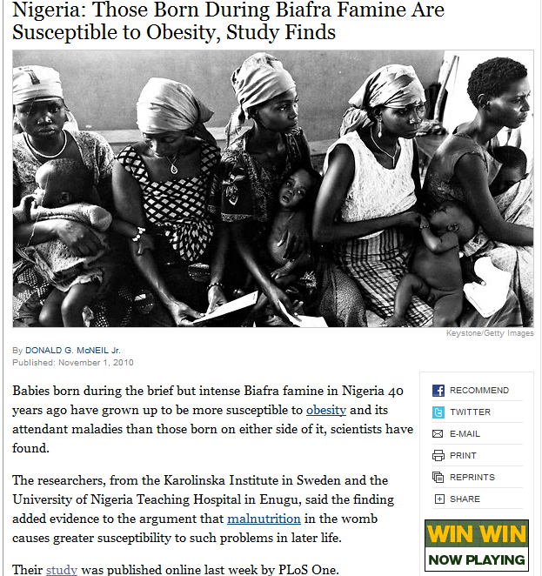


Slide 60
Tack

